Slide 1
SL Presenter Add-In
For PowerPoint Design Idea
Notes:
===HearMeSeeMe===
Hi, there, I had the best day of my life. Because I can explain to you using Hear me, See me.
===HearMeSeeMe===

Slide 2
Our Winning Build Components
SL Add-In for PowerPoint
Text to SL Converter
SL to Text to Speech Converter
Notes:
===HearMeSeeMe===
This project
===HearMeSeeMe===

Slide 3
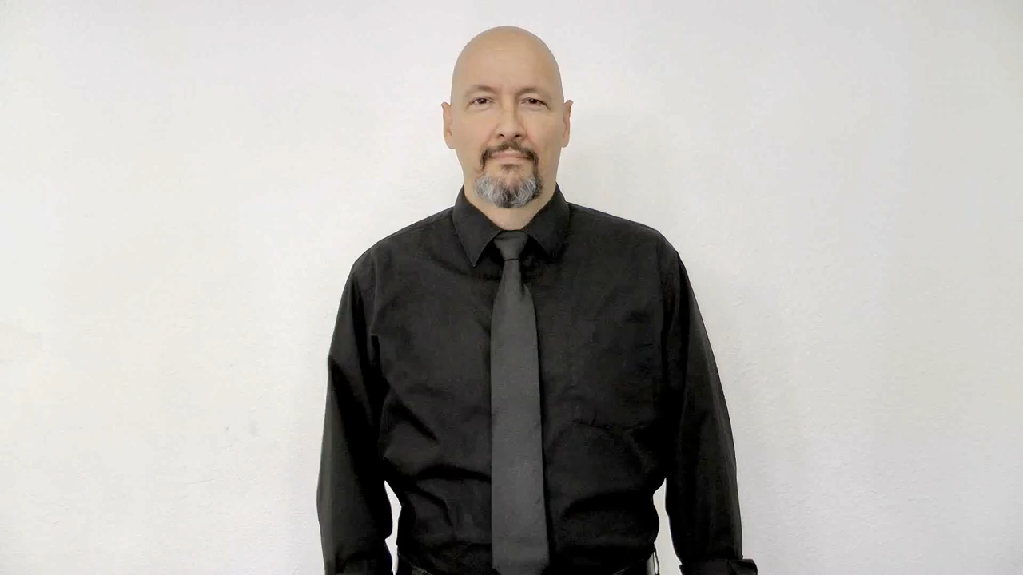
SL Add-In for PowerPoint
Add-In to PowerPoint
Narrator Avatar Window during Slide Show
Gif/Movie Container Picker
Speech Script Container-Pointer
Payload (Memory Management) during Slide Show*
5
1
4
2
3
*To be considered at a later stage but must take into serious consideration
Notes:
We focused on five areas:
Implement powerpoint add-in
Automatic video play during slide show
etc

Slide 4
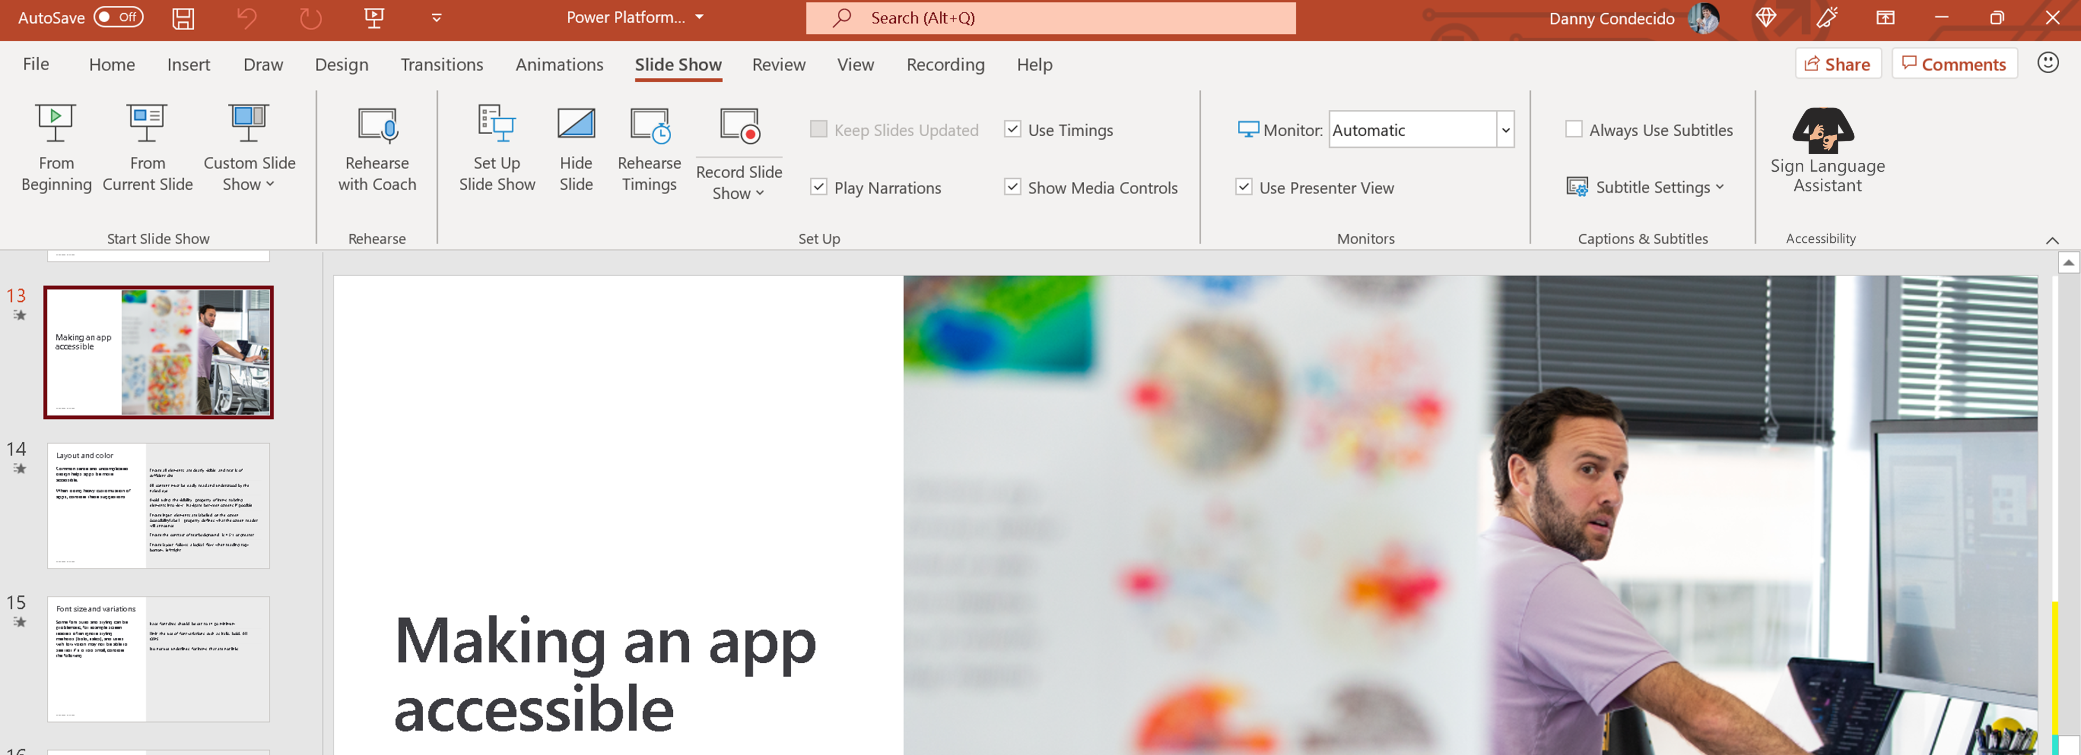
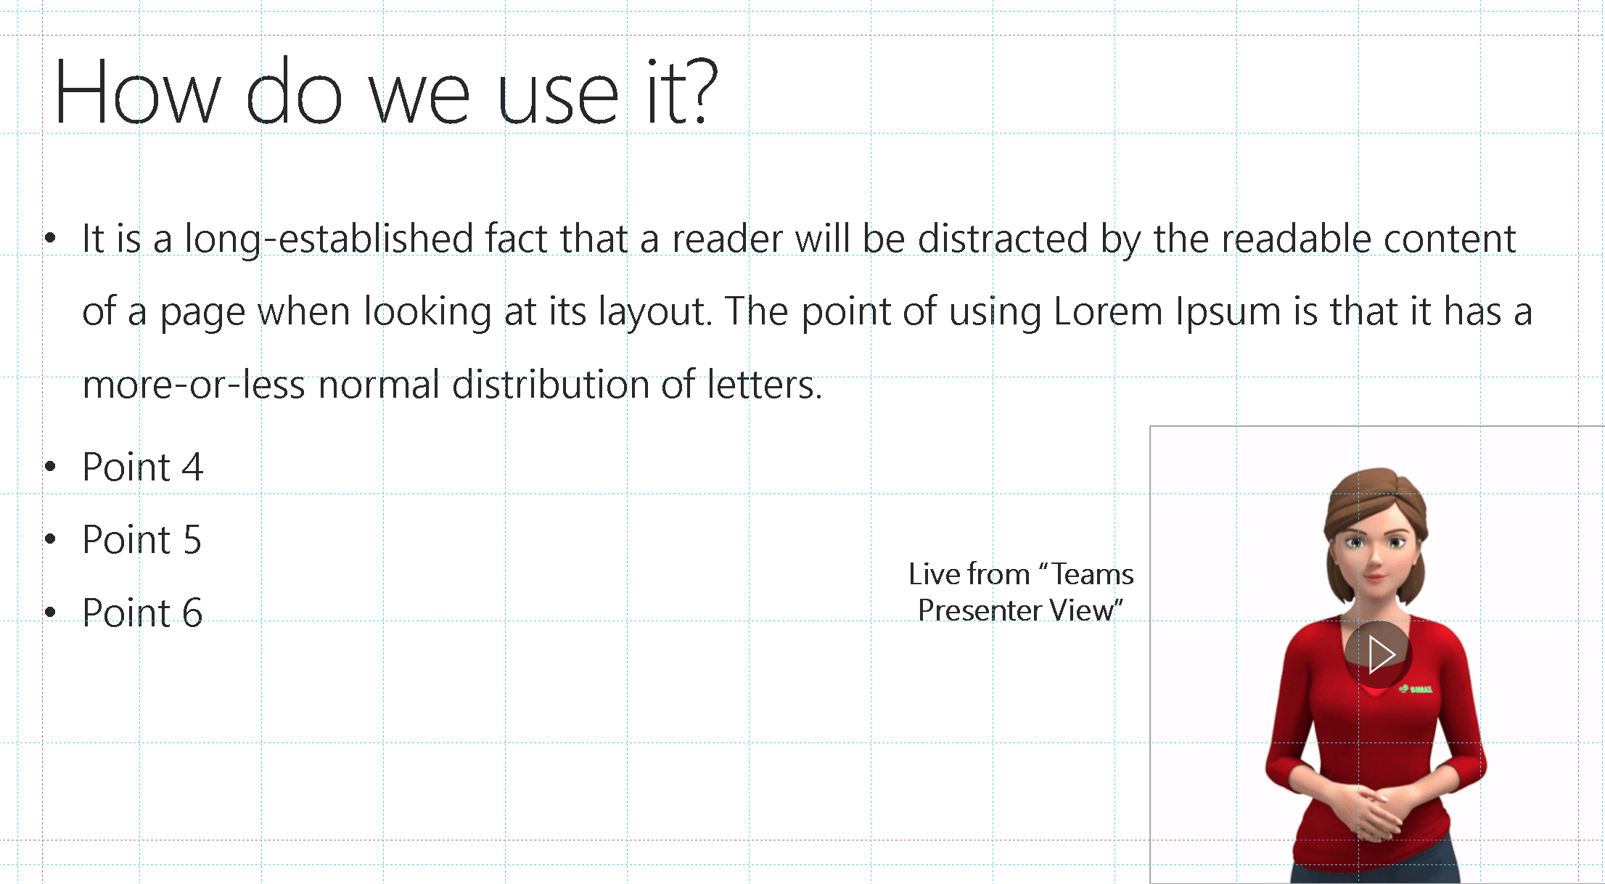
SL Presenter Add-In

Slide 5
Text to SL Converter
Identify
Identify speech script file and location
Recognise
Recognise supported file types = txt, docx
Parse
Parse and vectorize data frame (word, alphabet and numbers) speech script
Match
Match each vectorized word, alphabet and numbers to gif/movie library
Develop
Develop a fuzzy matching algorithm for vectorized data frame to gif/movie descriptor – T2SLFuzzy program
Load
Load T2SLFuzzy in memory to do background matching learning
Provide
Provide user readiness alert if T2SLFuzzy is completed for each slide

Slide 6

SL to Text and/or Speech Converter
Notes:
In this video you’ll learn how to:
Collect images for deep learning using your webcam and OpenCV
Label images for sign language detection using LabelImg
Setup Tensorflow Object Detection pipeline configuration
Use transfer learning to train a deep learning model
Detect sign language in real time using OpenCV Get the training template here: https://github.com/nicknochnack/RealT... Other Links Mentioned in the Video Face Mask Detection Video: https://youtu.be/IOI0o3Cxv9Q LabelImg: https://github.com/tzutalin/labelImg Installing the Tensorflow Object Detection API: https://tensorflow-object-detection-a...

Slide 7
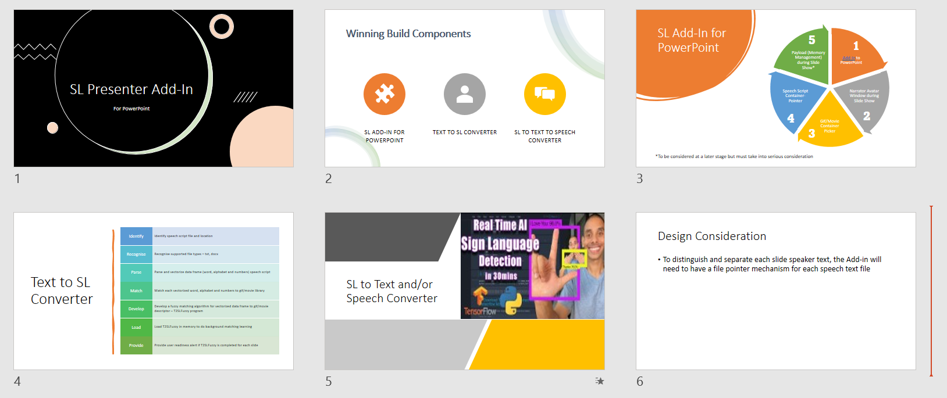
Design Consideration – Speaker Script
This is a stopgap measure
To distinguish and separate each slide speaker text, the Add-in will need to have a file pointer mechanism for each speech text file
Slide 1
Slide01.docx
Slide 2
Slide02.docx
Slide 3
Slide03.docx
Slide 4
Slide04.docx
Slide 5
Slide05.docx
Slide 6
Slide06.docx

Slide 8

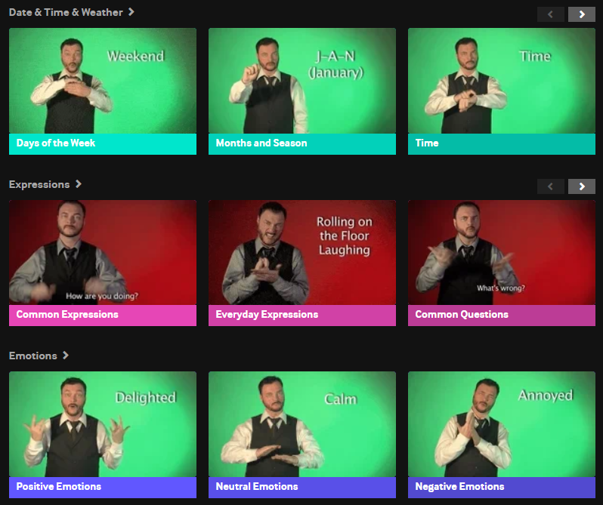
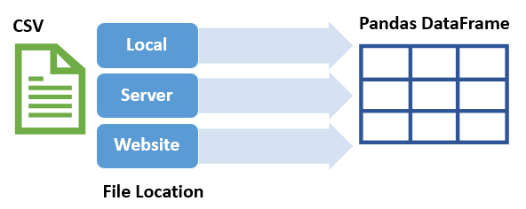
Design Consideration – T2SLFuzzy
This is a stopgap measure
To identify and match vector words from dataframe with our SL gif/movie library, we can use the file name (or any file descriptor) and train the model to enhance speed of identification
SL Images Repository
Speaker Script Parser

